Slide 1

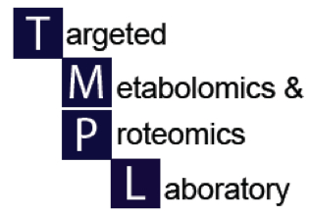

Metabolite identification in metabolomics: Database and interpretation of MSMS spectra
UAB Metabolomics Workshop
December 2, 2015
Jeevan K. Prasain, PhD
Department of Pharmacology and Toxicology, UAB
jprasain@uab.edu

Slide 2
Outline
Introduction
Available databases
Annotated chemical structures and de novo structure determination by MS/MS
Conclusions

Slide 3
Introduction
Identification of metabolites at a molecular level is the biggest bottleneck in metabolomics due to their structural diversity (isobars and isomers) and dynamic metabolism.
Considering the number of metabolites is >200,000, there is a lack of commercial analytical standards (only a few thousands available) or comprehensive databases.
  Note that there is the opportunity to make specific metabolite standards through the NIH Common Fund
  Go to http://metabolomicsworkbench.org
MS/MS interpretation is needed for validation of annotated structure and unknown determination.
Inclusion of many artifacts in databases.
Structural complexity of metabolites.

Slide 4
Keys to identifying chemical structures (putative/definitive) by mass spectrometry
Combination of the following:
  Retention time in LC
  Accurate mass
  Isotope distribution
  MS/MS product ions of a precursor ion
  Comparison with authentic standards (definitive)

Slide 5
Metabolite identification workflow
Raw LC-MS data
Data file processed by algorithms
(e.g., XCMS)
P-value, fold change
Metabolomics/chemical database search
(known/new or novel)
Interpretation of MS/MS of a precursor ion
(accurate mass, isotope data and nitrogen rule)
Putative identification
(molecular formula determination)
De novo structure elucidation
(NMR and or LC-MS/MS)

Slide 6
LCMS-based metabolomics
Detection of intact molecular ions [M+H]⁺/[M-H]⁻ is possible with soft ionization such as ESI
High mass accuracy of many instruments (<5 ppm, 0.0005%) helps identify isobaric compounds
Enables the separation of complex mixtures and identification of molecular weight of pure compounds
Substructures of unknown metabolite may be proposed on the basis of LC retention time, exact mass measurement and interpretation of signature ions upon MS/MS of a precursor ion

Slide 7
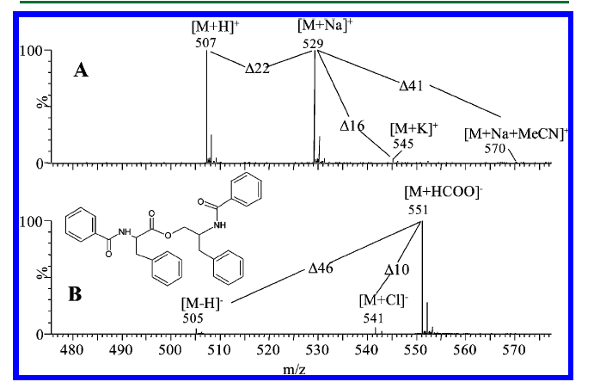
Not every peak represents individual metabolite:
Adduct formation
Nielsen et al., J Nat Prod. 2011
Notes:
Add a slide on expected adducts. Note that Mummichog lists the adducts it finds.

Slide 8
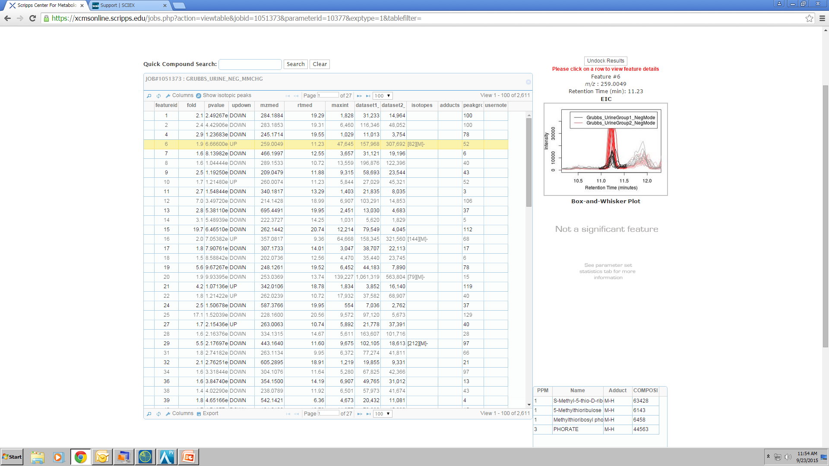
Platform to process untargeted
metabolomic data
Automated METLIN search

Slide 9
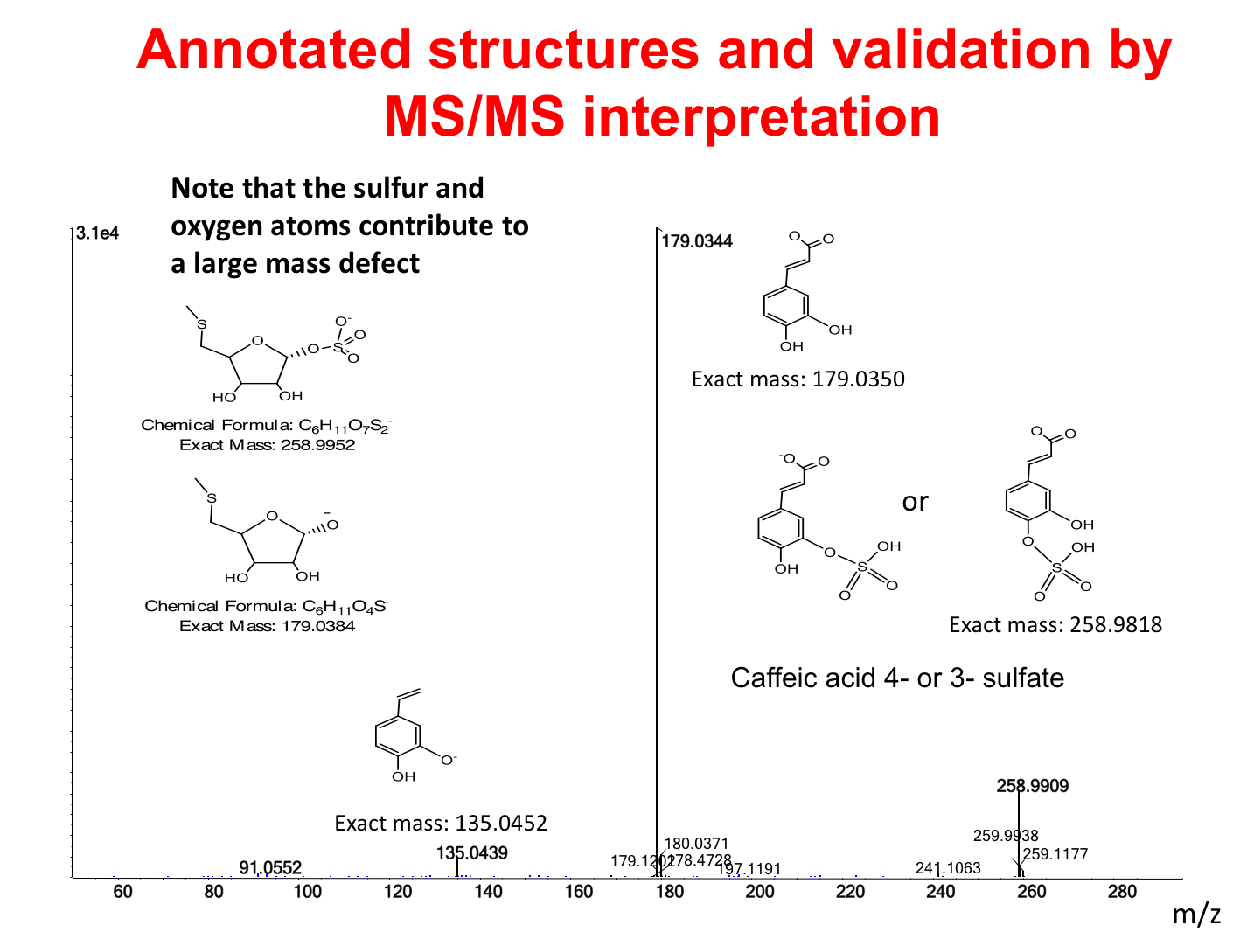

Slide 10
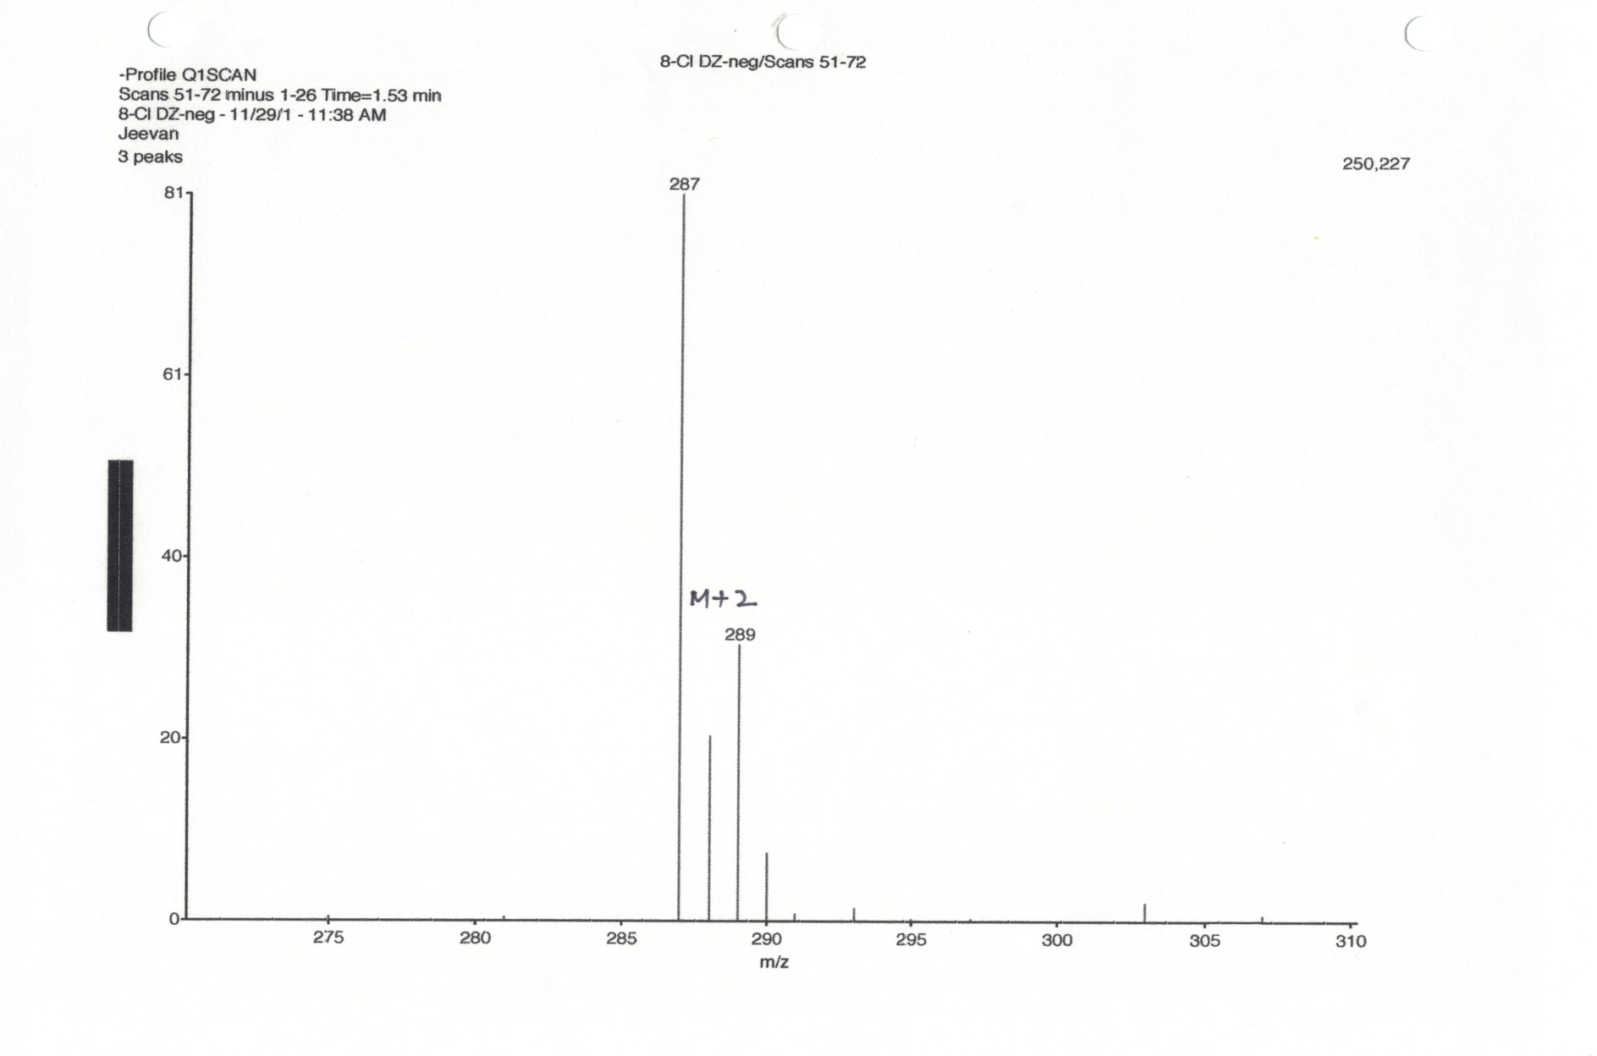
Isotopic pattern and intensity of ions indicates
the number of carbons and hetero atoms
in the molecular ion
287
¹H = 99.9%, ²H = 0.02%
¹²C = 98.9%, ¹³C = 1.1%
³⁵Cl = 68.1%, ³⁷Cl = 31.9%
289
288

Slide 11
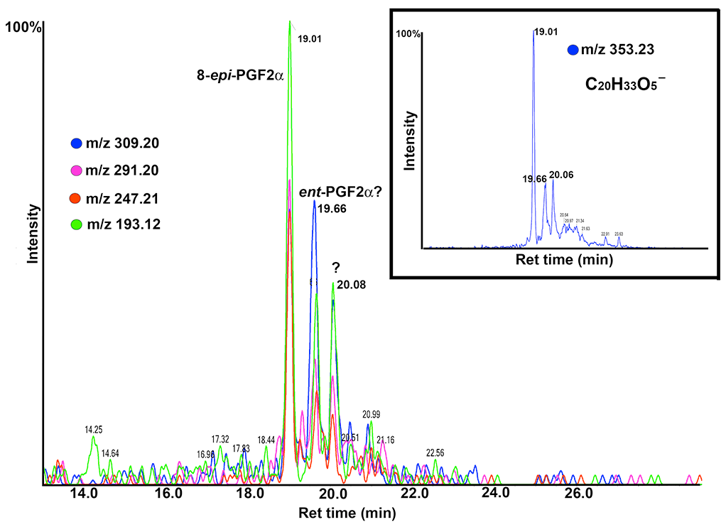
Good chromatographic separation and accurate mass
are the important steps in structure determination
Exact mass: 353.2333

Slide 12
Library search for eicosanoid http://www.lipidmaps.org/

Slide 13
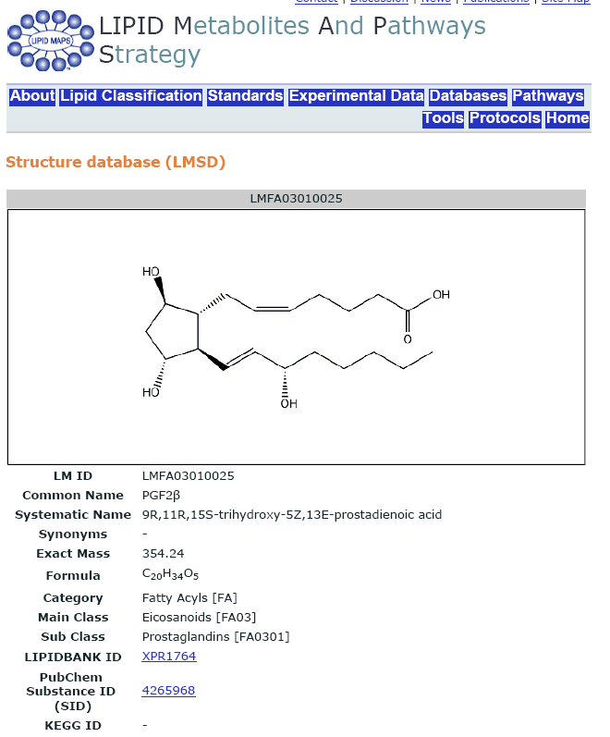
Library search for eicosanoid

Slide 14
Separation of stereoisomers requires
a chiral normal phase column
2000
4.73
Ent-PGF2alpha
Intensity, cps
0
0.5
2.0
3.5
5.0
6.5
8.0
4400
5.17
PGF2alpha
Intensity, cps
Hoang et al., PLOS Genetics. 2013
0
0.5
2.0
3.5
5.0
6.5
8.0

Slide 15
26000
0
120
180
240
300
360
420
480
540
600
660
720
780
840
Mass/Charge

Slide 16
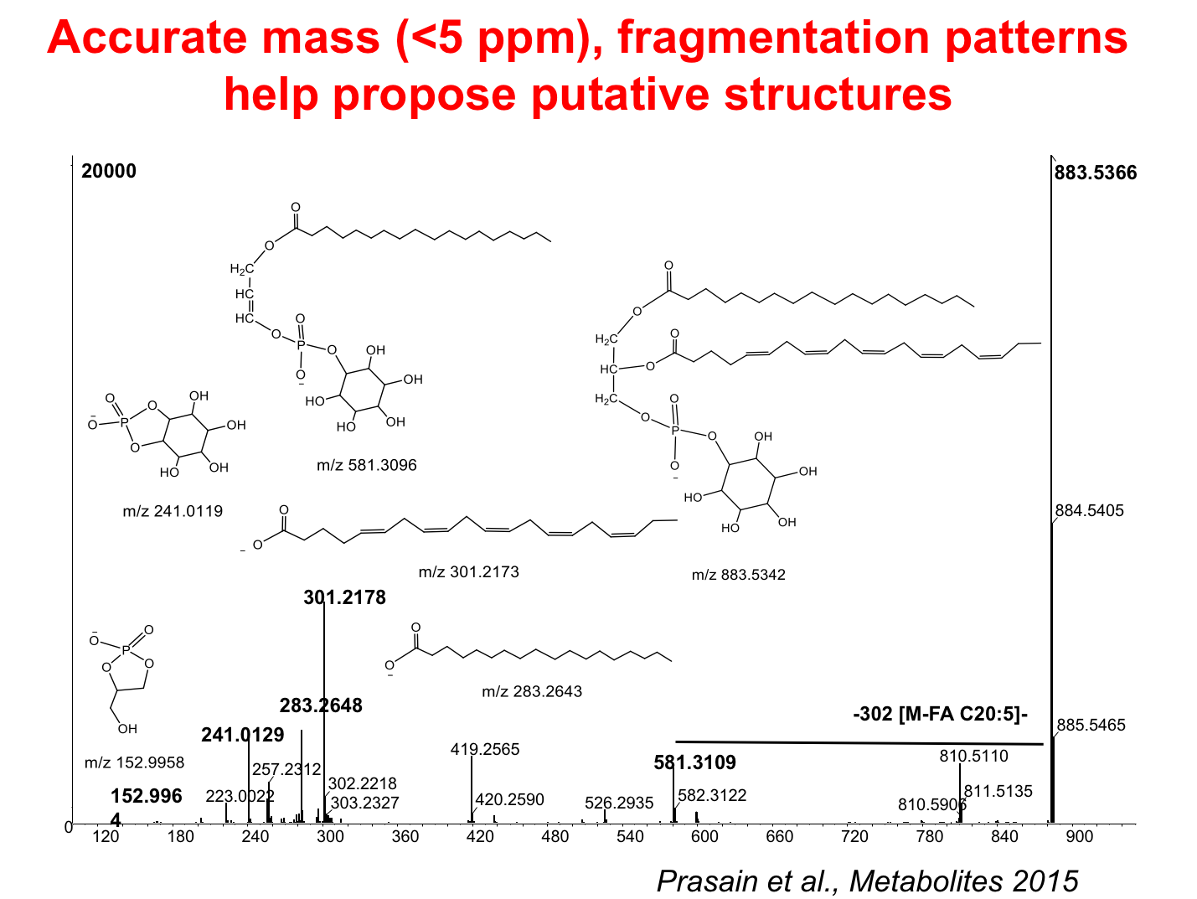
Notes:
Again, explanation of context is needed

Slide 17
Both of these flavonoids have identical molecular ion masses: distinguished by their MSMS spectra
[A]
Yo⁺
100
255.050
-162 Da
daidzin
%
256.057
[B]
0
100
297.043
-120 Da
267.037
%
321.046
268.041
307.065
351.044
281.051
335.061
363.046
381.055
0
240
260
340
m/z
220
280
300
320
360
380
Puerarin
Prasain et al., J. Agric. Food Chem., 2003

Slide 18
Targeted metabolomics: identification of conjugated metabolites
Examples - glucuronide/sulfate conjugates)

Slide 19
The loss of anhydrous glucuronic acid (176 Da)-
the characteristic of all glucuronides
100
269
Genistein
[M-H]-
Relative Intensity (%)
50
-176 Da
85
59
113
133
181
224
0
100
200
300
400
m/z

Slide 20
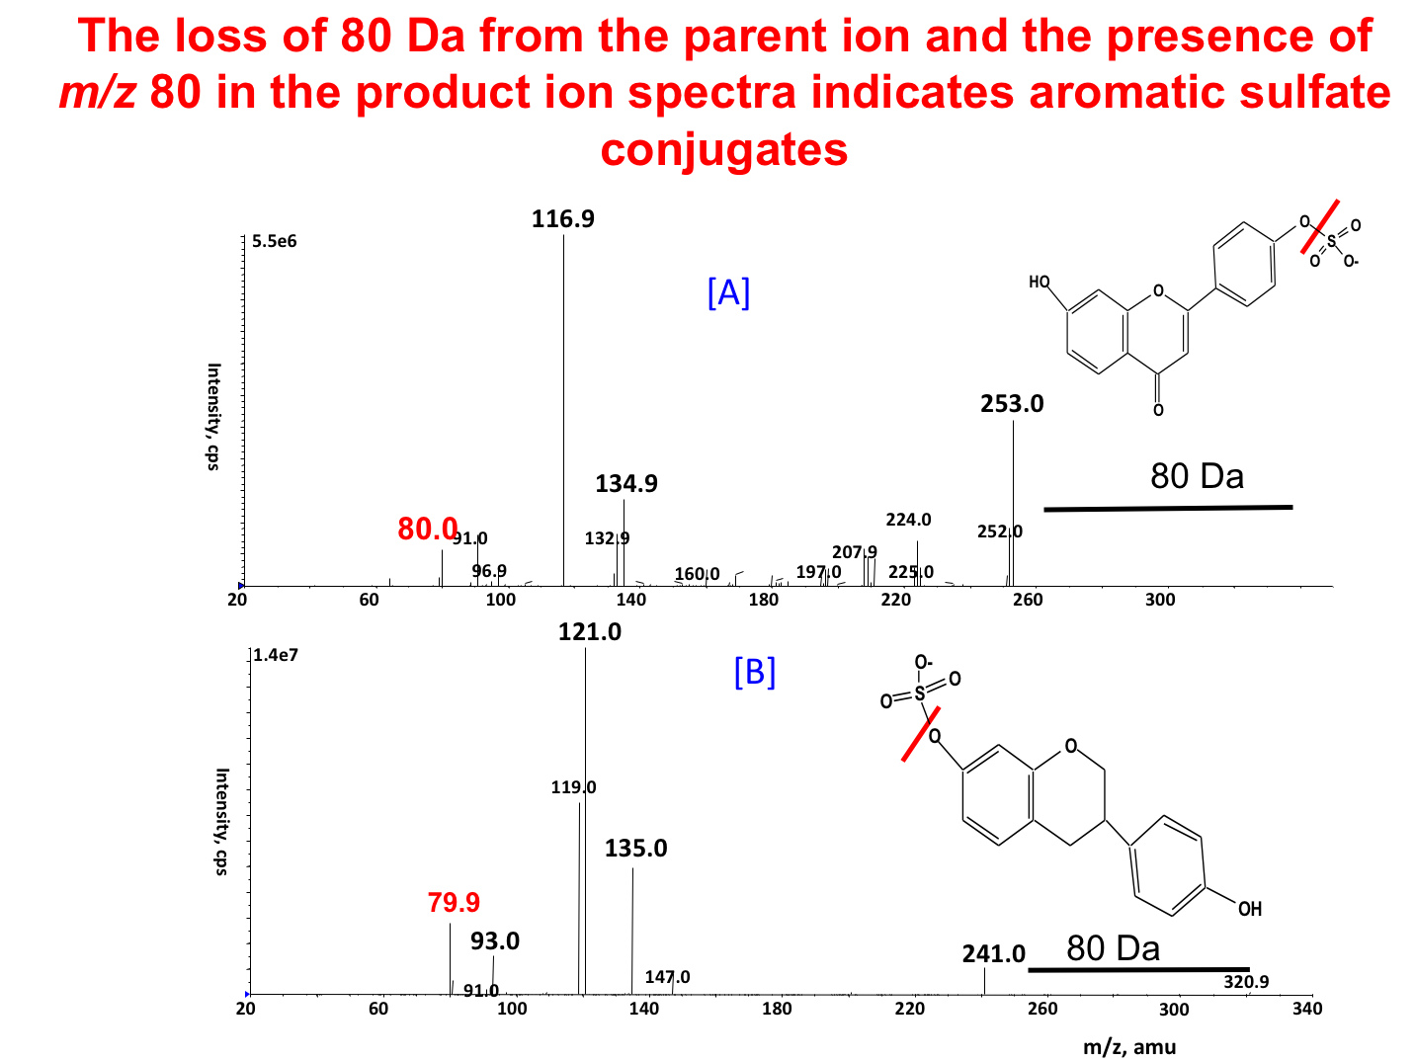

Slide 21
Characteristic fragmentation of metabolite
conjugates by MS/MS
Conjugate
Ionization mode
Scan
Glucuronides
pos/neg
NL 176 amu
Hexose sugar
pos/neg
NL 162 amu
Pentose sugar
pos/neg
NL 132 amu
Phenolic sulphate
pos
NL 80 amu
Phosphate
neg
Prec m/z 79, NL 80/98
GSH
Pos/neg
NL 129 amu
GSH
Neg
Prec m/z 272
taurines
Pos
Precursor of m/z 126
N-acetylcysteins
neg
NL 129 amu
NL = neutral loss.
Kostiainen et al., 2003

Slide 22
Conclusions
Identifying unknown metabolites is a significant analytical challenge in metabolomics and it requires integrated analytical and bio-informative approaches.
Data processing and data analysis are important for putative identifications.
The use of high-resolution MS and MS^{n} provides important information to propose structures of fragment and molecular ions.
If enough of the metabolite can be isolated, ¹H-NMR can establish which enantiomer it is.

